Slide 1
Algorithms analysis and Design
By : Dr. Basem Alijla

Slide 2
Chapter 6
Transform and Conquer

Slide 3
OUTLINE
Introduction to Transform and Conquer technique
instance simplification
Presorting
Gaussian Elimination
representation change
Balanced Search Trees
Heaps and Heapsort

Slide 4
Transform and Conquer
This group of techniques solves a problem by transformation
Two Stage procedure
Transform
The problem’s instance is modified to be more amenable to solution.
Conquer
Solve the Problem

Slide 5
Transform and Conquer
There are three major variations of transformation

Slide 6
Transform and Conquer
There are three major variations of transformation
instance simplification : transform to a simpler/more convenient instance of the same problem
representation change: transform to a different representation of the same instance
problem reduction: transform to a different problem for which an algorithm is already available

Slide 7
OUTLINE
Introduction to Transform and Conquer technique
instance simplification
Presorting
Gaussian Elimination
representation change
Balanced Search Trees
Heaps and Heapsort

Slide 8
Instance simplification - Presorting
Solve a problem’s instance by transforming it into another simpler/easier instance of the same problem
Presorting:
Many problems involving lists are easier when list is sorted
searching
checking if all elements are distinct (element uniqueness)
Computing the mode of a list

Slide 9
How fast can we sort ?
Efficiency of algorithms involving sorting depends on efficiency of sorting.
Selection and Insertion Sort O (n²)
Bubble Sort O(n²)
Quick and Merge Sort O (nlogn)

Slide 10
How fast can we sort ?
Theorem : n log₂ n comparisons are necessary in the worst case to sort a list of size n by any comparison-based algorithm
Note: About nlog₂ n comparisons are also sufficient to sort array of size n (mergesort).

Slide 11
Searching with presorting
Problem: Search for a given K in A[0..n-1]
Presorting-based algorithm:
Stage 1 : Sort the array by an efficient sorting algorithm
Stage 2 : Apply binary search
Efficiency: Θ(nlog n) + O(log n) = Θ(nlog n)
Good or bad?
Why do we have our dictionaries, telephone directories, etc. sorted?

Slide 12
Example: Searching
6 | 4 | 8 | 2 | 9 | 3 | 5 | 1 | 7
Sort the array by Merge sort algorithm ( O(n log n)
the Key Value ( 7 ) using Binary Search ( log n )
Found !
1 | 2 | 3 | 4 | 5 | 6 | 7 | 8 | 9
6 | 7 | 8 | 9

Slide 13
Element Uniqueness with presorting
Presorting-based algorithm
Stage 1 : Sort the array by an efficient sorting algorithm
Stage 2: scan array to check pairs of adjacent elements
Efficiency: Θ(nlog n) + O(n) = Θ(nlog n)
Brute force algorithm : Compare all pairs of elements
Efficiency: O(n²)

Slide 14
Example:
Sort the array by Merge sort algorithm ( O(n log n)
Compare the Adjacent pairs O(n )
6 | 4 | 8 | 2 | 9 | 3 | 5 | 1 | 3
1 | 2 | 3 | 3 | 4 | 5 | 6 | 8 | 9
1 | 2 | 3 | 3 | 4 | 5 | 6 | 8 | 9
1 | 2 | 3 | 3 | 4 | 5 | 6 | 8 | 9

Slide 15
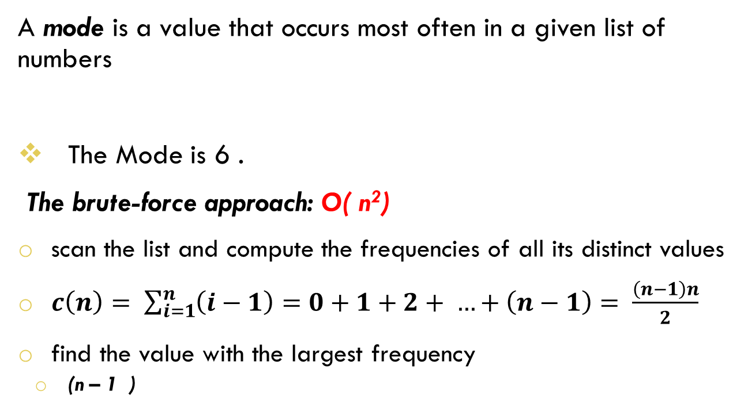
Computing a mode with presorting
A mode is a value that occurs most often in a given list of numbers
The Mode is 6 .
The brute-force approach: O( n²)
scan the list and compute the frequencies of all its distinct values
$c\left(n\right)= \sum_{i=1}^{n}{\left(i−1\right)=0+1+2+ …+\left(n−1\right)= \frac{\left(n−1\right)n}{2}}$
find the value with the largest frequency
(n – 1 )
6 | 4 | 6 | 2 | 9 | 6 | 5 | 2 | 5

Slide 16
Computing a mode with presorting
Presorting-based algorithm
Stage 1 : Sort the array by an efficient sorting algorithm
Stage 2: Find the longest run of adjacent equal values in the array
Efficiency: Θ(nlog n) + O(n) = Θ(nlog n)

Slide 17
Example: Computing a mode
Sort the array by Merge sort algorithm ( O(n log n)
Compare the Adjacent pairs O(n )
6 | 4 | 6 | 2 | 9 | 6 | 5 | 2 | 5
2 | 2 | 4 | 5 | 5 | 6 | 6 | 6 | 9
2 | 2 | 4 | 5 | 5 | 6 | 6 | 6 | 9
2 | 2 | 4 | 5 | 5 | 6 | 6 | 6 | 9
2 | 2 | 4 | 5 | 5 | 6 | 6 | 6 | 9

Slide 18
Computing a mode with presorting

Slide 19
OUTLINE
Introduction to Transform and Conquer technique
instance simplification
Presorting
Gaussian Elimination
representation change
Balanced Search Trees
Heaps and Heapsort

Slide 20
Instance simplification – Gaussian Elimination
Given: A system of n linear equations in n unknowns with an arbitrary coefficient matrix.
Transform to: An equivalent system of n linear equations in n unknowns with an upper triangular coefficient matrix.
Solve the latter by substitutions starting with the last equation and moving up to the first one.

Slide 21
Gaussian Elimination
a₁₁x₁ + a₁₂x₂ + … + a_{1n}x_{n} =b₁ |  | a₁₁x₁ + a₁₂x₂ + … + a_{1n}x_{n} b₁
a₂₁x₁ + a₂₂x₂ + … + a_{2n}x_{n} = b₂ |  | + a₂₂x₂ + .… + a_{2n}x_{n} = b₂
…..
a_{n1}x₁ + a_{n2}x₂ + … + a_{nn}x_{n}=b_{n} |  | +a_{nn}x_{n}=b_{n}

Slide 22
Gaussian Elimination
The transformation is accomplished by a sequence of elementary operations on the system’s coefficient matrix (which don’t change the system’s solution):
for i ←1 to n-1 do replace each of the subsequent rows (i.e., rows i+1, …, n) by a difference between that row and an appropriate multiple of the i-th row to make the new coefficient in the i-th column of that row 0

Slide 23
Example of Gaussian Elimination
Solve 2x₁ - 4x₂ + x₃ = 6 3x₁ - x₂ + x₃ = 11 x₁ + x₂ - x₃ = -3
coefficient matrix
2 | -4 | 1 | 6
3 | -1 | 1 | 11
1 | 1 | -1 | -3

Slide 24
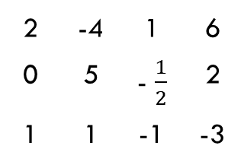
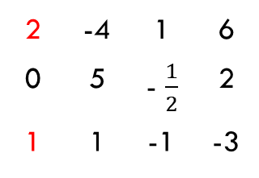
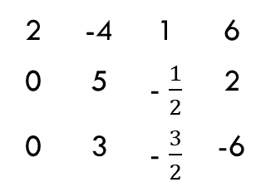
Example of Gaussian Elimination
Gaussian elimination
2 | -4 | 1 | 6
3 | -1 | 1 | 11
1 | 1 | -1 | -3
2 | -4 | 1 | 6
0 | 5 | - $\frac{1}{2}$ | 2
1 | 1 | -1 | -3
row2 – (3/2)*row1
2 | -4 | 1 | 6
0 | 5 | - $\frac{1}{2}$ | 2
1 | 1 | -1 | -3
2 | -4 | 1 | 6
0 | 5 | - $\frac{1}{2}$ | 2
0 | 3 | - $\frac{3}{2}$ | -6
row3 – (1/2)*row1

Slide 25
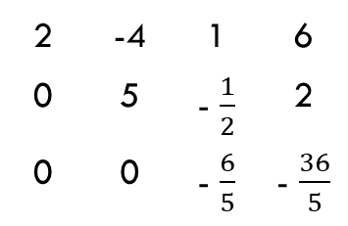
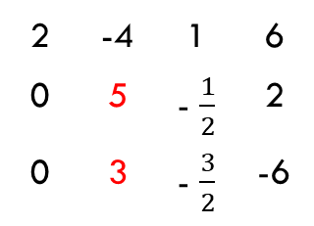
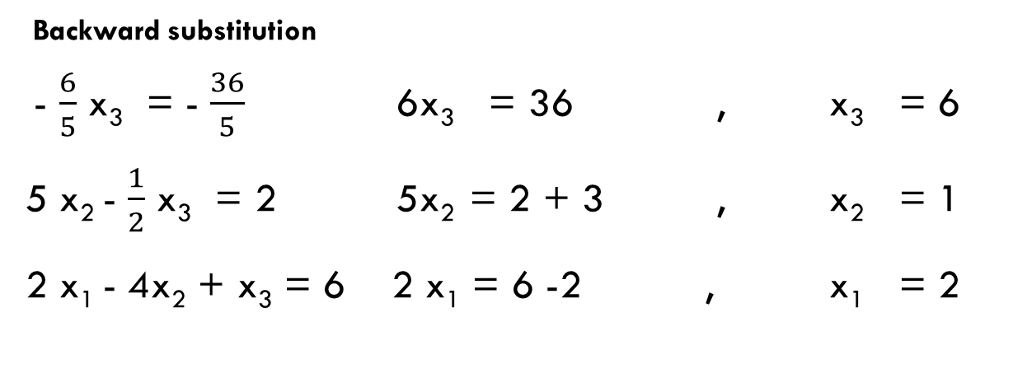
Example of Gaussian Elimination
2 | -4 | 1 | 6
0 | 5 | - $\frac{1}{2}$ | 2
0 | 3 | - $\frac{3}{2}$ | -6
2 | -4 | 1 | 6
0 | 5 | - $\frac{1}{2}$ | 2
0 | 0 | - $\frac{6}{5}$ | - $\frac{36}{5}$
row3 – (3/5)*row2
upper triangular coefficient matrix.
Backward substitution
- $\frac{6}{5}$ x₃ = - $\frac{36}{5}$ 6x₃ = 36 , x₃ = 6
5 x₂ - $\frac{1}{2}$ x₃ = 2 5x₂ = 2 + 3 , x₂ = 1
2 x₁ - 4x₂ + x₃ = 6 2 x₁ = 6 -2 , x₁ = 2

Slide 26
Pseudocode and Efficiency of Gaussian Elimination
Stage 1: Reduction to an upper-triangular matrix
for i ← 1 to n-1 do
for j ← i+1 to n do for k ← i to n+1 do A[j, k] ← A[j, k] - A[i, k] * A[j, i] / A[i, i]
Θ(n³)

Slide 27
Pseudocode and Efficiency of Gaussian Elimination
Stage 2: Back substitutions
for j ← n downto 1 do
t ← 0
for k ← j +1 to n do
t ← t + A[j, k] * x[k] x[j] ← (A[j, n+1] - t) / A[j, j]
Θ(n²)
Efficiency: Θ(n³) + Θ(n²) = Θ(n³)

Slide 28
Assignment 1
Write An Algorithm that compute the mode in a list with complexity less than n log n , in other word with a complexity not grater than O( n)

Slide 29
OUTLINE
Introduction to Transform and Conquer technique
instance simplification
Presorting
Gaussian Elimination
representation change
Balanced Search Trees
Heaps and Heapsort

